Slide 1
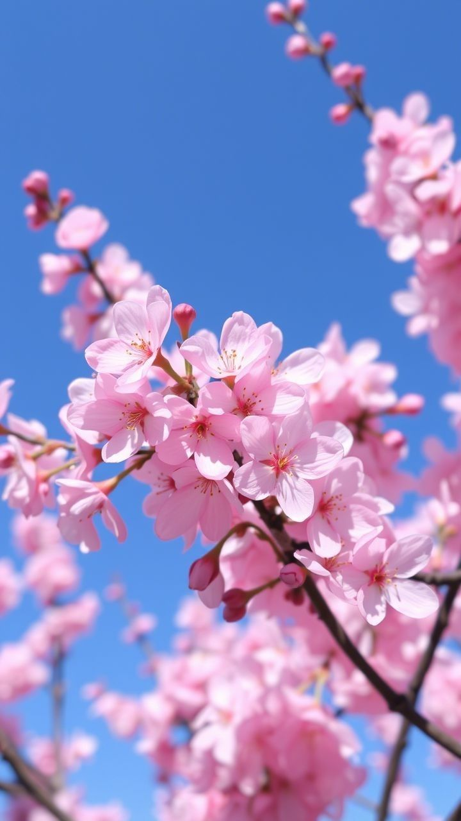
Spring
The quick brown fox jumps over the lazy dog. The quick brown fox jumps over the lazy dog. The quick brown fox jumps over the lazy dog. The. The quick brown fox jumps over the lazy dog.

Slide 2

Summer
The quick brown fox jumps over the lazy dog. The quick brown fox jumps over the lazy dog. The quick brown fox jumps over the lazy dog. The quick brown fox jumps over the lazy dog. The quick brown fox jumps over the lazy dog.

Slide 3
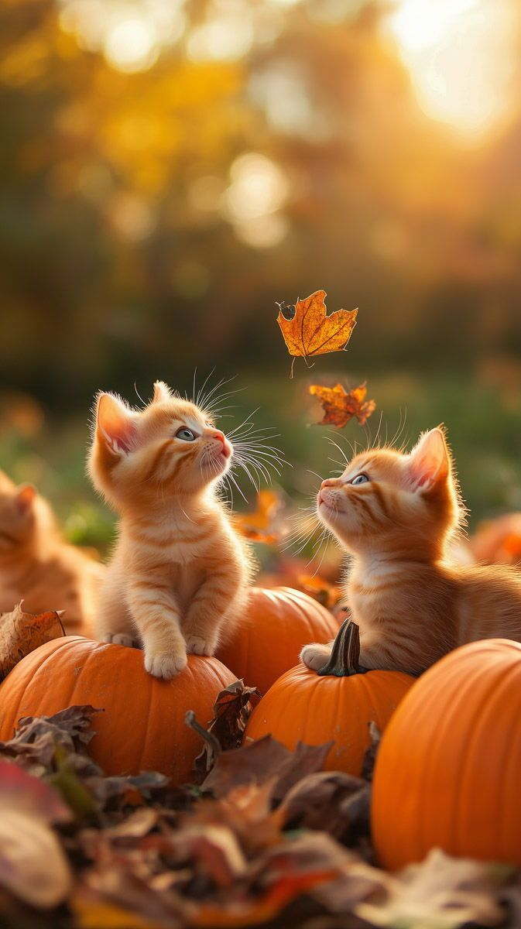
Atumn
The quick brown fox jumps over the lazy dog. The quick brown fox jumps over the lazy dog. The quick brown fox jumps over the lazy dog. The quick brown fox jumps over the lazy dog. The quick brown fox jumps over the lazy dog.

Slide 4

Winter
The quick brown fox jumps over the lazy dog. The quick brown fox jumps over the lazy dog. The quick brown fox jumps over the lazy dog. The quick brown fox jumps over the lazy dog. The quick brown fox jumps over the lazy dog.

